Slide 1
CSE422: Artificial intelligence
Probability
Asif Shahriar
Lecturer, CSE, BRACU

Slide 2
You PROBABLY Know These
Probability of an Event is defined by how LIKELY the event is to occur in an experiment
If we repeat an experiment many times and record how often an event E happens, then probability of event E : P(E) = Number of times E occurs​ / Total number of trials
In a coin toss, probability of heads occurring: P(head) = 1 / 2 = 0.5
In a fair dice rolling (where all faces of the dice are equal)
Probability of getting 4: P(4) = 1 / 6
Probability of NOT getting 4: P(not 4) = 1 - P(4) = 1 - 1/6 = 5/6
Probability of getting an even number = P({2, 4, 6}) = P(2) + P(4) + P(6) = 3/6 = 0.5

Slide 3
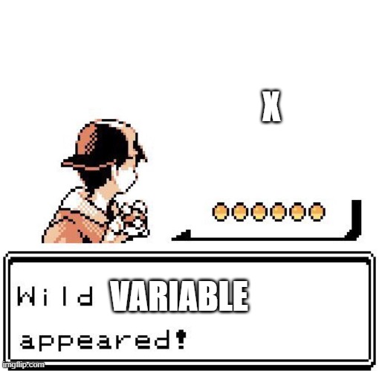
Random Variables

Slide 4
Random Variables
A Random Variable (RV) is an aspect of the environment for which we have some uncertainty
A Random variable can have ONE of a set of values from its domain, each with an associated probability
Example: Weather is a RV with domain = {sunny, rainy, cloudy, snowy}
Domain values must be exhaustive and mutually exclusive
Random variable can be DISCRETE or CONTINUOUS
Discrete RV can take a discrete value from a finite range. Example: weather, mark you will get in the MID
Continuous RV can take ANY value from an infinite / continuous range. Example: Temperature of a day
Let X be a RV defined as the SUM of two fair dice, what are the domain values?

Slide 5
Probability Distribution
A probability distribution assigns a probability to each value of a Random Variable
Let X be a random variable that represents YOUR CURRENT MODE, with the domain being {bored, sleepy, annoyed, excited, anxious about mid marks}
P(X = bored) = 0.25
P(X = sleepy) = 0.20
P(X = annoyed) = 0.10
P(X = excited) = 0.05
P(X = anxious about mid marks) = 0.4
We write this as: P(X) = <0.25, 0.20, 0.10, 0.05, 0.4> [called Vector Notation]
The sum of all probabilities in a distribution must be 1 : TRUE or FALSE?

Slide 6
Some Notations
Suppose weather is a discrete RV with the domain {sunny, rainy, cloudy, snowy}
“Weather = sunny” is written as “sunny”
“P(Weather = sunny) = 0.6” is written as “P(sunny) = 0.6”
Suppose cavity is a discrete RV with the domain {TRUE, FALSE}
“Cavity = TRUE” is written as “cavity”
“Cavity = False” is written as “¬cavity”
“P(Cavity = False) = 0.6” is written as “P(¬cavity) = 0.6”
Probability distribution is often presented in a table
P(Weather) = <0.6, 0.15, 0.24, 0.01> is the same as:
Weather | Probability
sunny | 0.60
rainy | 0.15
cloudy | 0.24
snowy | 0.01

Slide 7
Joint Probability Distribution
Probability distribution over a SET of Random variables (i.e. two or more random variables are being considered)
Let’s consider two boolean RVs: Toothache and Cavity
Sum of ALL entries in the joint probability distribution table must be 1
Every question about a domain can be answered by looking at the table
Quiz: P(cavity, toothache) = ? P(¬cavity, toothache) = ?
Quiz: If I have cavity, probability of toothache is 0.22 -> TRUE or FALSE?
 | toothache | ¬toothache
cavity | 0.22 | 0.15
¬cavity | 0.08 | 0.55

Slide 8
Marginal Probability Distribution
Probability of a proposition is the sum of probabilities of all events where that proposition holds TRUE
P(cavity) = sum of all events where (Cavity=cavity) holds = 0.22 + 0.15 = 0.37
P(¬toothache) = sum of all events where (Toothache=¬toothache) holds = 0.15 + 0.55 = 0.70
Quiz: P(¬cavity) = ? P(toothache) = ?
 | toothache | ¬toothache
cavity | 0.22 | 0.15
¬cavity | 0.08 | 0.55

Slide 9
AND OR
P(A ∪ B) = P(A) + P (B) - P(A ∩ B)
P(A ∩ B) = P(A) × P(B) [ONLY IF A and B are independent, else not]
P(A ∪ B) is also written as P(A ∨ B)
P(A ∩ B) is also written as P(A ∧ B)

Slide 10
Quiz on Probability Distribution
Let’s consider a Joint probability distribution with THREE boolean RV: H, B, S

Slide 11
Quiz on Probability Distribution
Let’s consider a Joint probability distribution with THREE boolean RV: H, B, S
H | B | S | Prob.
+h | +b | +s | 0.44
+h | +b | -s | 0.15
+h | -b | +s | 0.14
+h | -b | -s | 0.07
-h | +b | +s | 0.10
-h | +b | -s | 0.04
-h | -b | +s | 0.05
-h | -b | -s | 0.01

Slide 12
Quiz on Probability Distribution
Let’s consider a Joint probability distribution with THREE boolean RV: H, B, S
H | B | S | Prob.
+h | +b | +s | 0.44
+h | +b | -s | 0.15
+h | -b | +s | 0.14
+h | -b | -s | 0.07
-h | +b | +s | 0.10
-h | +b | -s | 0.04
-h | -b | +s | 0.05
-h | -b | -s | 0.01
P(+h, -b, +s) = 0.14
P(+b) = 0.44 + 0.15 + 0.10 + 0.04 = 0.73
P((+h, -b) OR +s)
= P(+h, -b) + P(+s) - P(+h, -b, +s)
= (0.14 + 0.07) + (0.44 + 0.14 + 0.10 + 0.05) - 0.14
= 0.80

Slide 13
Conditional Probability
Conditional probability is the probability of an event A occurring given that another event B has already occurred
Written as P(a∣b) [read as Probability of a given b] and defined by:
P(a ∣ b) = P(a ∩ b) / P(b)
Also written as P(a ∣ b) = P(a, b) / P(b)
Here b is evidence (we know its probability) and a is query (we WANT to know its probability)
Probability of toothache IF i have cavity
= P(toothache | cavity)
= P(toothache, cavity) / P(cavity)
= 0.22 / (0.22 + 0.15)
= 22 / 37 = 0.595
 | toothache | ¬toothache
cavity | 0.22 | 0.15
¬cavity | 0.08 | 0.55

Slide 14
Conditional Probability
 | Male | Female
GoT | 0.16 | 0.24
BB | 0.2 | 0.05
TBBT | 0.1 | 0.25
P(GoT | Male) = ?
P(Male | GoT) = ?
P(TBBT | Female) = ?

Slide 15
Conditional Probability
 | Male | Female
GoT | 0.16 | 0.24
BB | 0.2 | 0.05
TBBT | 0.1 | 0.25
P(GoT | Male) = P(GoT, Male) / P(Male) = 0.16 / 0.46 = 0.3478
P(Male | GoT) = P(Male, GoT) / P(GoT) = 0.16 / 0.4 = 0.4
P(TBBT | Female) = ? Do it yourself

Slide 16
Conditional Probability
From the joint probability distribution given above, find the probability that a randomly selected person is:
Male given right handed
Right handed given male
Female given left handed
Are the events “being female” and “being left handed” INDEPENDENT?
 | Right handed | Left handed
Male | 0.41 | 0.08
Female | 0.45 | 0.06

Slide 17
Conditional Probability
From the joint probability distribution given above, find the probability that a randomly selected person is:
Male given right handed [0.477]
Right handed given male [0.837]
Female given left handed [0.429]
Are the events “being female” and “being left handed” INDEPENDENT? [No]
 | Right handed | Left handed
Male | 0.41 | 0.08
Female | 0.45 | 0.06

Slide 18
Marginal Probability
 | toothache |  | ¬toothache
 | shows | ¬shows | shows | ¬shows
cavity | 0.108 | 0.012 | 0.072 | 0.008
¬cavity | 0.016 | 0.064 | 0.144 | 0.576
Consider three Boolean RV Toothache, Cavity, and ShowsOnXRay
P(cavity) = ?
P(toothache) = ?
P(cavity ∨ toothache) = ?

Slide 19
Marginal Probability via Conditioning
 | toothache |  | ¬toothache
 | shows | ¬shows | shows | ¬shows
cavity | 0.108 | 0.012 | 0.072 | 0.008
¬cavity | 0.016 | 0.064 | 0.144 | 0.576
If A and B are two boolean RVs,
P(a) = P(a ^ b) + P (a ^ ¬b) [easier to find if Joint distribution table given]
In other words, P(a) = P(a | b) × P(b) + P(a | ¬b) × P(¬b) [if table not given]
P(cavity) = P(cavity ^ shows ^ toothache) + P(cavity ^ ¬shows ^ toothache) + P(cavity ^ shows ^ ¬toothache) + P(cavity ^ ¬shows ^ ¬toothache)

Slide 20
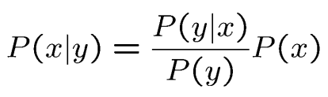
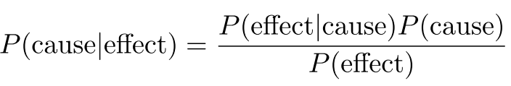
BAYES’ Rule
From the formula of conditional probability P(x ∣ y) = P(x, y) / P(y), we can infer: P(x, y) = P (x | y) × P(y) [called the product rule]
Similarly, P(x, y) = P (y | x) × P(x)
Dividing we get:
In other words:
Why is this SO important?
It is hard to know the cause, but it is easy to see the effect
Using this formula, we can infer the cause by analyzing the effect

Slide 21
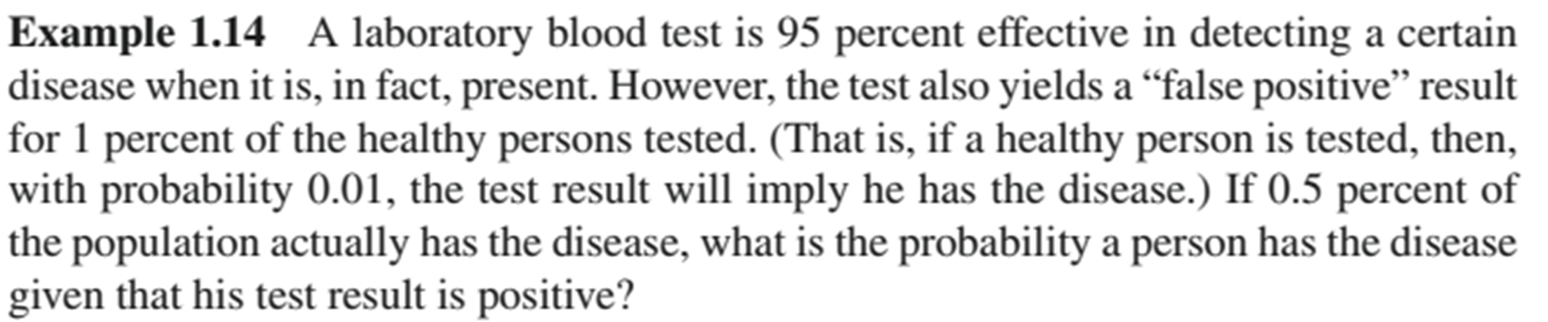
BAYES’ Rule

Slide 22
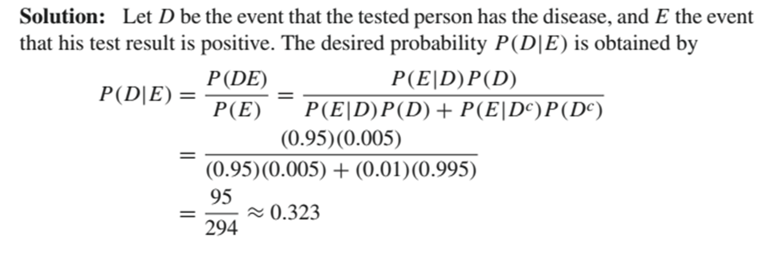
BAYES’ Rule
Note: If A and B are boolean RV:
P(a | b) + P (¬a | b) = 1
P(a, b) + P (a, ¬b) = P(a)

Slide 23
BAYES’ Rule
A person is brought in front of a jury. The jury finds the defendant guilty in 98% of the cases in which they indeed committed the crime; and it finds the defendant not guilty 97% of the cases when the defendant did not commit the crime. Only 0.8% of the population has committed a crime.
If a person is found guilty by the jury, what is the probability that person has truly committed the crime?
Answer: 49 / 235 = 0.2085

Slide 24
BAYES’ Rule
Wilson’s disease is a very rare disease, only about 0.005% people are affected with it (this is an imaginary value, actual rate is even lower). Unfortunately, during a routine medical checkup, your uncle has been diagnosed with it. The best hospital in Bangladesh is 97% effective in diagnosing this disease (if a person has it, the hospital detects it correctly). In 2% cases the hospital falsely detects it in a person (the person does not actually have it). Now, you are no medical expert, but you DO know probabilistic theory. Based on the information available to you, would you suggest your uncle starts treatment right away, or would you suggest your uncle performs a second test in Singapore to check if he actually has it? Explain with mathematical reasoning.
Ans: 2.42X10^-3

Slide 25
Chain Rule of Conditional Probability
We know, P(a, b) = P(a | b) × P(b) [product rule]
We can extend this using chain rule of multiplication
P(a, b | c) = P(a, b, c) / P(c)
Hence, P(a, b, c) = P(a, b | c) × P(c)
P(a | b, c) = P(a, b, c) / P(b, c)
Hence, P(a, b, c) = P(a | b, c) × P(b, c)
P(a, b, c, d, e) = P(a | b, c, d, e) × P(b, c, d, e)
= P(a | b, c, d, e) × P(b | c, d, e) × P(c, d, e)
= P(a | b, c, d, e) × P(b | c, d, e) × P(c | d, e) × P(d, e)
= P(a | b, c, d, e) × P(b | c, d, e) × P(c | d, e) × P(d | e)× P(e)

Slide 26
Probabilistic Independence
If two events A and B are independent, then the probability of A occurring does not depend on B
So, P(A | B) = P(A)
Hence, P(A ^ B) = P(A | B) × P(B) = P(A) × P(B) [proved]
This is also called absolute independence
Consider the joint distribution of the RVs Toothache, Cavity, and ShowsOnXRay
Suppose we bring in another RV Weather = {sunny, cloudy, rainy, snowy}
Dental problems have no effect on weather
So, P(Weather = cloudy | toothache, cavity, shows) = P(Weather = cloudy)
P(Weather = cloudy, toothache, cavity, shows) = P(Weather = cloudy) × P(toothache, cavity, shows)
Caution! P(toothache, clavity) ≠ P(toothache) × P(cavity) [toothache and cavity are not independent]

Slide 27
Probabilistic Independence
 | Male | Female
GoT | 0.16 | 0.24
BB | 0.2 | 0.05
TBBT | 0.1 | 0.25
Are Male viewers and GoT independent?
P(Male ^ GoT) = ? P(Male)= ? P(GoT) = ?
Is P(Male ^ GoT) = P(Male) × P(GoT)?

Slide 28
Conditional Independence
A and B are conditionally independent given C, then the probability of A occurring given C does not depend on B, and vice versa
In notation: P(A | B, C) = P(A | C)
Similarly, P(B | A, C) = P(B | C)
Consider the OG boolean RVs Toothache, Cavity, Shows
If I have cavity, probability of X-Ray showing it does not depend on whether I have toothache or not
P(+shows | +toothache, +cavity) = P(+shows | +cavity)
Same independence holds if I do not have cavity
P(+shows | +toothache, –cavity) = P(shows | –cavity)

Slide 29
Conditional Independence
Mathematically we can show that A and B are conditionally independent given C iff P(A, B | C) = P(A | C) × P(B | C)
In that case we can decompose the joint distribution:
P(A ∧ B ∧ C) = P(A | C) P(B | C) P(C) [Note: P(A ∧ B ∧ C) is the same as P(A, B, C)]
Since the random variable Shows is conditionally independent of Toothache given Cavity
P(Shows ^ Toothache | Cavity) = P(Shows | Cavity) × P(Toothache | Cavity)

Slide 30
Independence Check
To prove that A and B are absolutely independent, we need to show that
P(A, B) = P(A) × P(B)
To prove that A and B are conditionally independent given C, we need to show that:
P(A, B | C) = P(A | C) × P(B | C)

Slide 31
Conditional Independence
 | toothache |  | ¬toothache
 | shows | ¬shows | shows | ¬shows
cavity | 0.108 | 0.012 | 0.072 | 0.008
¬cavity | 0.016 | 0.064 | 0.144 | 0.576
From this join distribution, find out whether the random variables Shows and Toothache are independent given Cavity
Is P(Shows ^ Toothache | Cavity) = P(Shows | Cavity) × P(Toothache | Cavity)?
P(Shows ^ Toothache | Cavity) = ?
P(Shows | Cavity) = ?
P(Toothache | Cavity) = ?

Slide 32
Conditional Independence
 | toothache |  | ¬toothache
 | shows | ¬shows | shows | ¬shows
cavity | 0.108 | 0.012 | 0.072 | 0.008
¬cavity | 0.016 | 0.064 | 0.144 | 0.576
From this join distribution, find out whether the random variables Shows and Toothache are independent given Cavity
Is P(Shows ^ Toothache | Cavity) = P(Shows | Cavity) × P(Toothache | Cavity)?
P(Shows ^ Toothache | Cavity) = 0.54
P(Shows | Cavity) = 0.9
P(Toothache | Cavity) = 0.6

Slide 33
Exercise
 | smart |  | ¬smart
 | study | ¬study | study | ¬study
prepared | .432 | .16 | .084 | .008
¬prepared | .048 | .16 | .036 | .072
Queries:
What is the prior probability of smart?
What is the prior probability of study?
What is the conditional probability of prepared, given study and smart?
Save these answers for later! ☺

Slide 34
Exercise
 | smart |  | ¬smart
 | study | ¬study | study | ¬study
prepared | .432 | .16 | .084 | .008
¬prepared | .048 | .16 | .036 | .072
Queries:
Is smart independent of study?
Is prepared independent of study?

Slide 35
Exercise
 | smart |  | ¬smart
 | study | ¬study | study | ¬study
prepared | .432 | .16 | .084 | .008
¬prepared | .048 | .16 | .036 | .072
Queries:
Is smart conditionally independent of prepared, given study?
Is study conditionally independent of prepared, given smart?

